Slide 1

        lesson 19
  Internet Basics

Slide 2
This lesson includes the following sections:
    The Internet: Then and Now
    How the Internet Works
    Major Features of the Internet
    Online Services
    Internet Features in Application Programs

Slide 3
    The Internet: Then and Now
The Internet was created by the Advanced Research Projects Agency (ARPA) and the U.S. Department of Defense for scientific and military communications.
The Internet is a network of interconnected networks. Even if part of its infrastructure was destroyed, data could flow through the remaining networks.
The Internet uses high-speed data lines, called backbones, to carry data. Smaller networks connect to the backbone, enabling any user on any network to exchange data with any other user.

Slide 4
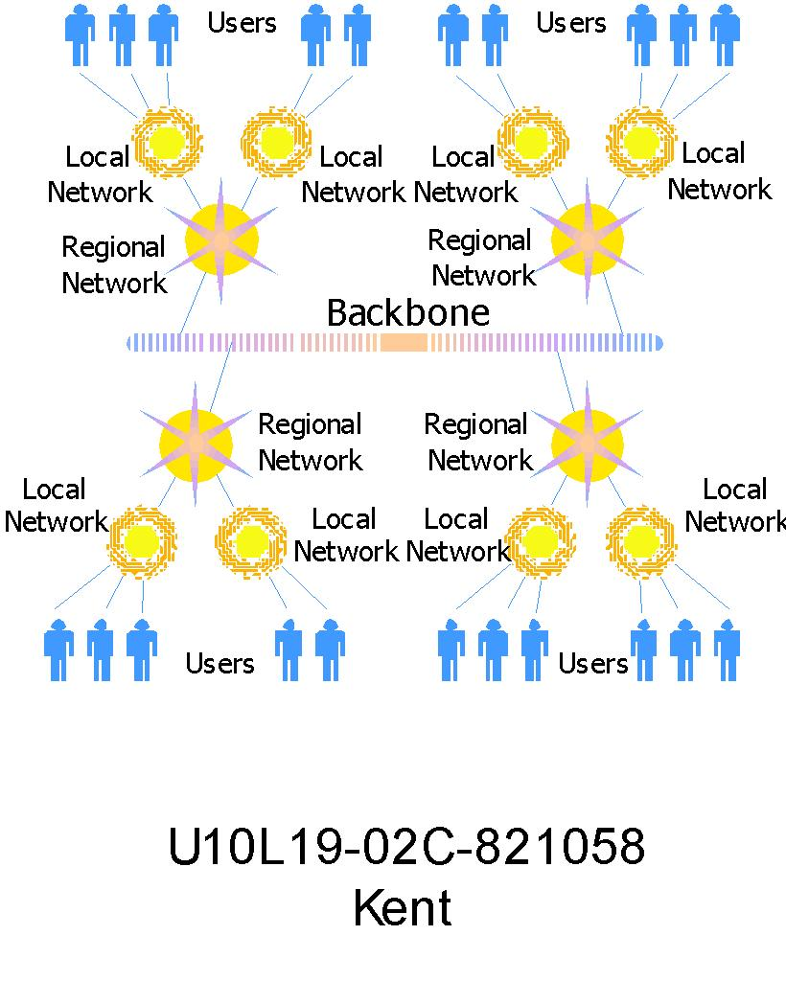

Slide 5
    How the Internet Works
TCP/IP
Routing Traffic Across the Internet
Addressing Schemes
Domains and Subdomains

Slide 6
    How the Internet Works - TCP/IP
Every computer and network on the Internet uses the same protocols (rules and procedures) to control timing and data format.
The protocol used by the Internet is the Transmission Control Protocol/Internet Protocol, or TCP/IP.
No matter what type of computer system you connect to the Internet, if it uses TCP/IP, it can exchange data with any other type of computer.

Slide 7
How the Internet Works -
Routing Traffic Across the Internet
Most computers don't connect directly to the Internet. Instead, they connect to a smaller network that is connected to the Internet backbone.
The Internet includes thousands of host computers (servers), which provide data and services as requested by client systems.
When you use the Internet, your PC (a client) requests data from a host system. The request and data are broken into packets and travel across multiple networks before being reassembled at their destination.

Slide 8
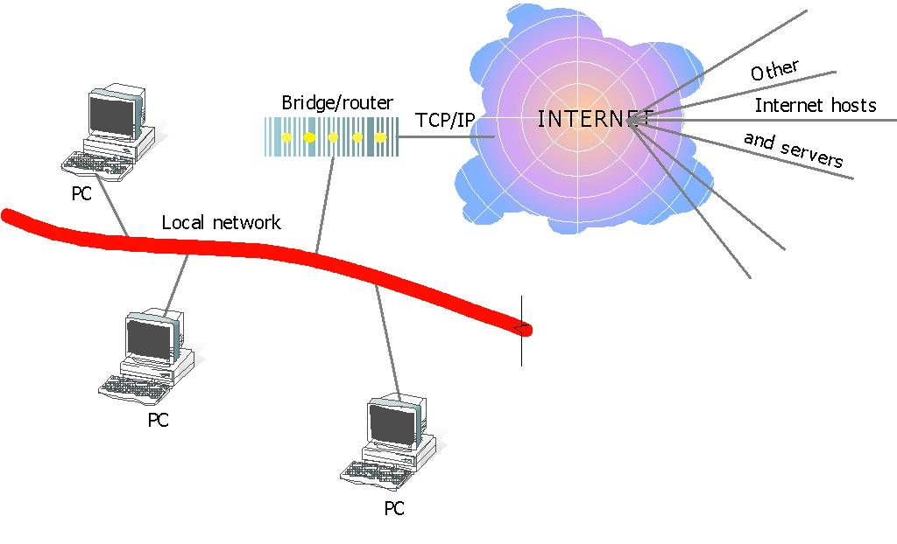

Slide 9
    How the Internet Works -
    Addressing Schemes
In order to communicate across the Internet, a computer must have a unique address.
Every computer on the Internet has a unique numeric identifier, called an Internet Protocol (IP) address.
Each IP address has four parts – each part a number between 0 and 255. An IP address might look like this: 205.46.117.104.

Slide 10
    How the Internet Works -
    Domains and Subdomains
In addition to an IP address, most Internet hosts or servers have a Domain Name System (DNS) address, which uses words.
A domain name identifies the type of institution that owns the computer. An Internet server owned by IBM might have the domain name ibm.com.
Some enterprises have multiple servers, and identify them with subdomains, such as products.ibm.com.

Slide 11
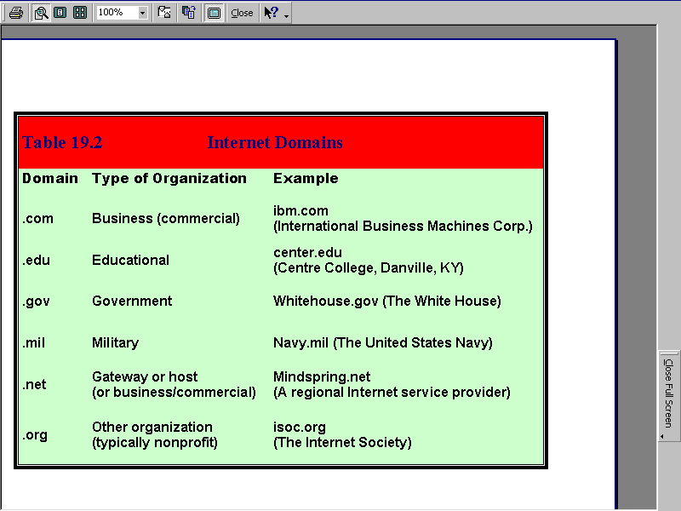

Slide 12
Major Features of the Internet
The World Wide Web
E-Mail
News
Telnet
File Transfer Protocol (FTP)
Internet Relay Chat (IRC)

Slide 13
    Major Features of the Internet -
    The World Wide Web
  The World Wide Web is a part of the Internet, which supports hypertext documents, allowing users to view and navigate different types of data.
  A Web page is a document encoded with hypertext markup language (HTML) tags.
  HTML allows designers to link content together via hyperlinks.
  Every Web page has an address, a Uniform Resource Locator (URL).

Slide 14
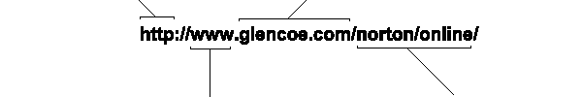
This address is for an
Internet server that uses
The hypertext transfer protocol.
This site belongs to a
company named Glencoe.
This site is on the part
of the Internet known
as the World Wide Web.
To find the specific Web pages
that accompany this book, your
browser follows the URL’s path
to a folder named “norton,” then
to a subfolder named “online.”

Slide 15
    Major Features of the Internet - E-Mail
Electronic mail (e-mail) is the most popular reason people use the Internet.
To create, send, and receive e-mail messages, you need an e-mail program and an account on an Internet mail server with a domain name.
To use e-mail, a user must have an e-mail address, which you create by adding your user name to the
e-mail server's domain name, as in jsmith@aol.com.

Slide 16
Major Features of the Internet - News
One Internet-based service, called news, includes tens of thousands of newsgroups.
Each newsgroup hosts discussions on a specific topic. A newsgroup's name indicates its users' special topic of interest, such as alt.food.cake.
To participate in a newsgroup, you need a newsreader program that lets you read articles that have been posted on a news server. You can post articles for others to read and respond to.

Slide 17
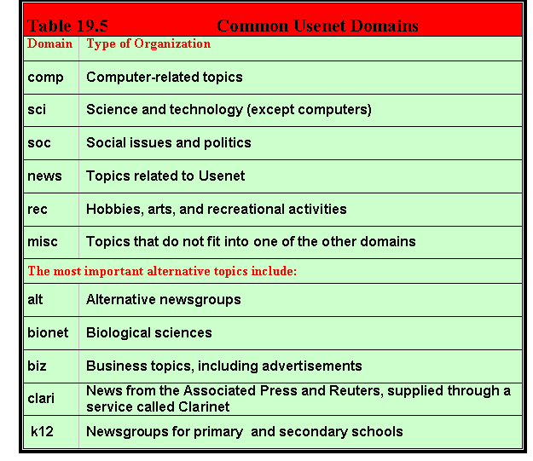

Slide 18
Major Features of the Internet - Telnet
Telnet is a specialized service that lets you use one computer to access the contents of another computer – a Telnet host.
A Telnet program creates a "window" into the host so you can access files, issue commands, and exchange data.
Telnet is widely used by libraries, to allow visitors to look up information, find articles, and so on.

Slide 19
Major Features of the Internet -
File Transfer Protocol (FTP)
File transfer protocol (FTP) is the Internet tool used to copy files from one computer to another.
Using a special FTP program or a Web browser, you can log into an FTP host computer over the Internet and copy files onto your computer.
FTP is handy for finding and copying software files, articles, and other types of data. Universities and software companies use FTP servers to provide visitors with access to data.

Slide 20
Major Features of the Internet –
Internet Relay Chat (IRC)
Internet Relay Chat (IRC) is a service that allows users to communicate in real time by typing text in a special window.
Like news, there are hundreds of IRC "channels," each devoted to a subject or user group.
You can use a special IRC program to participate in chatroom discussions, but many chatrooms are set up in Web sites, enabling visitors to chat directly in their browser window.

Slide 21
Online Services
An online service is a company that provides access to e-mail, discussion groups, databases on various subjects, and the Internet.
America Online, CompuServe, and Prodigy are examples of popular online services.

Slide 22
Internet-Related Features in Application Programs
Popular application programs, such as word processors and spreadsheets, feature Internet-related capabilities.
Using these special features, you may be able to create content for publication on the Internet or view content directly from the Internet.

Slide 23
lesson 19 review
Name the two organizations that created the network now called the Internet.
Explain the importance of TCP/IP to the Internet.
Describe the basic structure of the Internet.
List the major services the Internet provides to its users.
Identify two key Internet-related features found in many software applications.

